Slide 1
Python for data transformation

Slide 2
Course outline
Evaluate vectors, matrices, and arrays in Python (Module: numpy)
Use Python modules to work with vectors
Use Python modules to work with matrices
Use Python modules to interact with elements of matrices
Use Python modules to interact with elements of arrays
Use Python modules to reshape arrays

Slide 3

Contents
Data Transformation
Python for Data Transformation
Pandas - Series
Pandas – data frames
Manipulating data frames

Slide 4
Data Transformation
Data transformation is the process of converting data from one particular format to another required format.
In a typical scenario where data conversion is crucial, information needs to be cleansed before it is transformed.
Data cleansing or cleaning helps companies prepare data for transformation by eliminating errors, missing values, or inconsistencies.
Post this, the data is ready to be transformed.

Slide 5
Data Transformation
An enterprise can choose among a variety of ETL tools that automate the process of data transformation.
Data analysts, data engineers, and data scientists also transform data using scripting languages such as Python or domain-specific languages like SQL.
Data transformation can increase the efficiency of analytic and business processes and enable better data-driven decision-making
Data transformation is crucial because the format of data is very important for any application and transforming into our required format is crucial

Slide 6
Data Transformation
First phase of data transformation can include things like conversion of data types, mapping of data structures and flattening of hierarchical data.
Translation of data from one format to another format. Parsing a web page in HTML or XML structure into rows and columns data for easy processing
Data may be consolidated by filtering out unnecessary fields, columns, and records.
set of transformations can reshape data without changing content. This includes casting and converting data types for compatibility, adjusting dates and times with offsets and format localization, and renaming schemas, tables, and columns for clarity.

Slide 7
Python for Data Transformation
Due to its vast ecosystem of third-party libraries, packages and easy to use kind for developers, python has become the most used language for data transformation
Python is often used by developers for data transformation
Data transformation is most necessary for applications such as machine learning and big data, and python is the most used language for those
Python provides various modules, libraries and packages for data transformation such as pandas, numpy, tensorflow, pytorch etc

Slide 8
Pandas
Pandas is a python library for data manipulation and analysis
Pandas is a Python library used for working with data sets.
It has functions for analyzing, cleaning, exploring, and manipulating data.
It offers data structures and operations for manipulating numerical tables and time series. Pandas allows us to analyze big data and make conclusions based on statistical theories.
Pandas can clean messy data sets, and make them readable and relevant.

Slide 9
Pandas - basics
Pandas is a python library for data manipulation and analysis
Pandas library can be used to import, manipulate, process and create files in different forms such as CSV, TSV and JSON etc.
To read CSV files using Pandas, pandas’s read_csv() function is used
Pandas library can be imported as follows
import pandas as pd

Slide 10
Pandas - Series
Pandas Series is similar to column in a table.
It is a one-dimensional heterogeneous array holding data of any type
A series S maps an index to its values. It is:
Like an ordered dictionary
A NumPy array with row labels and a name
If nothing else is specified, the values are labeled with their index number. First value has index 0, second value has index 1 etc.

Slide 11
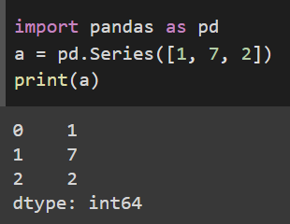
Pandas - Series
Pandas series can be created using Series method as
x= pd.Series(values, index = index, name = name)
pd.Series({‘index1’:val1 , ‘index2’:val2}) where values, index and name are sequences or arrays
List of numbers is passed as an argument to Series function to create a series which is ordered and has default index starting from zero

Slide 12
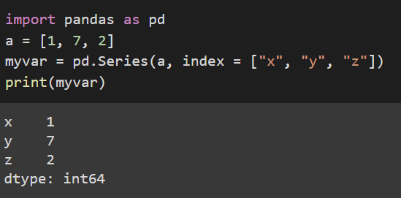
Pandas - Series
If nothing else is specified, the values are labeled with their index number. First value has index 0, second value has index 1 etc.
With the index argument, you can name your own labels.
As you can see list of characters to use as index is passed to create a series which has indices x,y and z

Slide 13
Pandas Data Frames
Data Frame is a 2-dimensional labeled data structure with columns of potentially different types.
You can think of it like a spreadsheet or SQL table, or a dictionary of Series objects.
It is generally the most commonly used pandas object
A data frame df maps index and column labels to values. It is:
Like a dictionary of series (Columns) sharing the same index
A 2D NumPy array with row and column labels

Slide 14
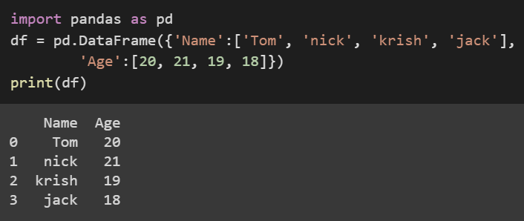
Pandas Data Frames
Data frame is the most used Pandas object
Data frame can be created in pandas as:
Df = pd.DataFrame(values, index = index, Columns = col_names)
Where values is a sequence of sequences or a 2D array

Slide 15
Indexing and Slicing Data Frames
Indexing and slicing data frames can be done in 3 different ways
Using [ ]
Using loc
Using iloc
On data frames [] refers to column labels. Column labels in previous example are name and age. [] can also be used to slice the data frame
Df[[‘Name’, ‘Age’]] will return another data frame which has only Name and Age columns in it.

Slide 16
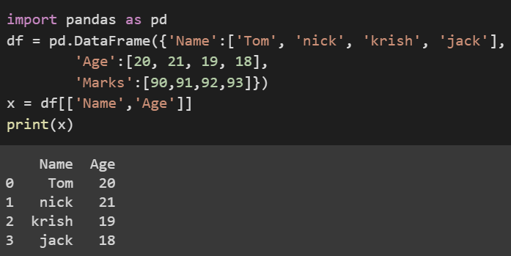
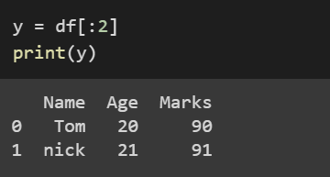
Indexing and Slicing Data Frames
Df[[‘Name’, ‘Age’]] will return another data frame which has only Name and Age columns in it.
Df[:2] will return a data frame which contains first 2 rows of the data frame Df

Slide 17
Indexing and Slicing Data Frames - loc
df.loc[] refers only to the index labels
Some common indexing and slicing patterns using loc are
df.loc[rows] : Some rows (all columns in a data frame)
Df.loc[:, cols_list] : All rows , some columns
Df.loc[rows, cols] : Subset of rows and columns
Df.loc[mask]: Boolean mask of rows, all columns
Df.loc[mask, cols] : Boolean mask of rows, some columns

Slide 18
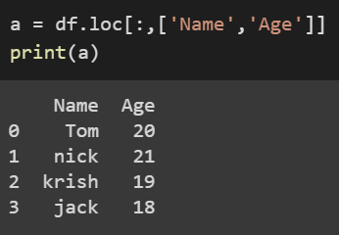
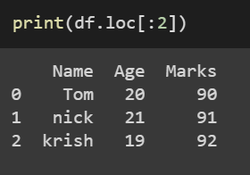
Indexing and Slicing Data Frames - loc
Here we are locating all rows and Specific columns age and name from the data frame df and storing in another data frame a
This will return a data frame which contains first 3 rows of the data frame Df unlike using [] as here the index mentioned is inclusive

Slide 19
Important attributes and methods
Below are some of the important attributes and methods of a data frame object
Df.index : array like row labels
Df.columns: array like column labels
Df.values: Numpy array, data
Df.shape : (no of rows, no of cols)
len(df) : number of rows
df.head(x) : x number of first rows
df.tail(y) : y number of last rows
Df.describe() : Summary stats
Df.info() : Memory usage

Slide 20
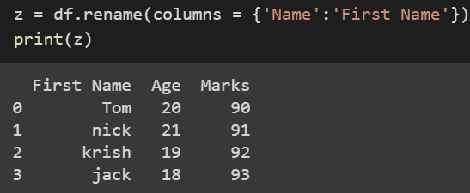
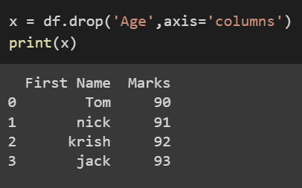
Manipulating Data Frames - Columns
Renaming columns:
Df.rename(columns = {old_name : new_name})
Drop Columns:
Df.drop(names, axis = ‘columns’)

Slide 21
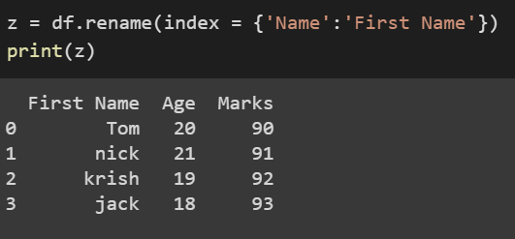
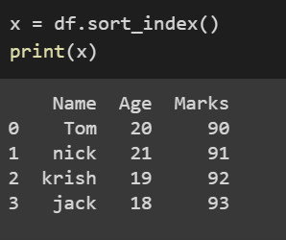
Manipulating Data Frames - Index
Renaming index labels:
Df.rename(index = {old_label : new_label})
sort index labels:
Df.sort_index()

Slide 22
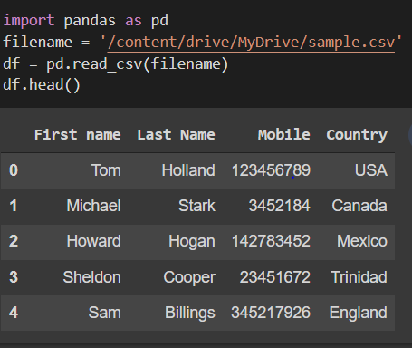
Importing CSV files with Pandas
read_csv() function returns the data present in csv file as a dataframe
Filename is passed into the read_csv() function
Instead of file name an URL can also be passed
URL consisting the file
Other parameters are set to default
Df is a data frame and data gets stored in it
Df.head() displays the first 5 rows

Slide 23
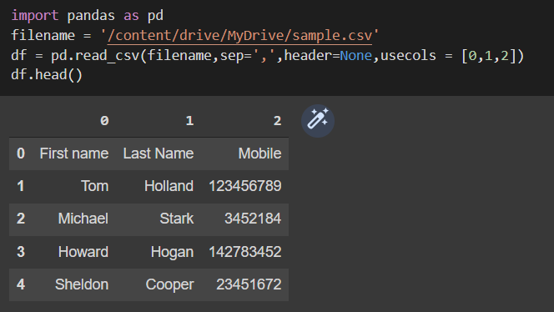
Importing CSV files with Pandas
importing data from csv file with separator as ‘,’ and no header with subset of first 3 columns and default indices.

Slide 24
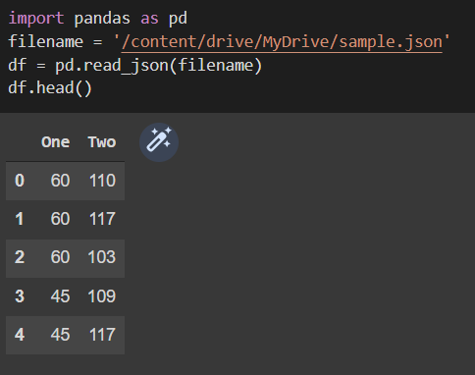
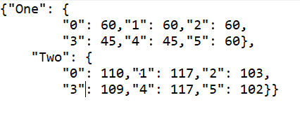
Importing JSON files with Pandas
read_json() function returns the data present in json file as a dataframe
Filename is passed into the read_json() function
Instead of file name an URL can also be passed
Other parameters are optional and set to defaults

Slide 25
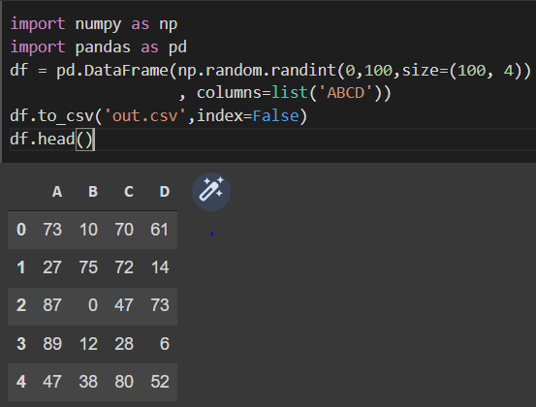
Generating Random Data with Pandas
Pandas data frame can be used to convert the data which is randomly generated using numpy library random module
Later the generated data stored in a pandas data frame can be converted into suitable file format and stored for further use.

Slide 26
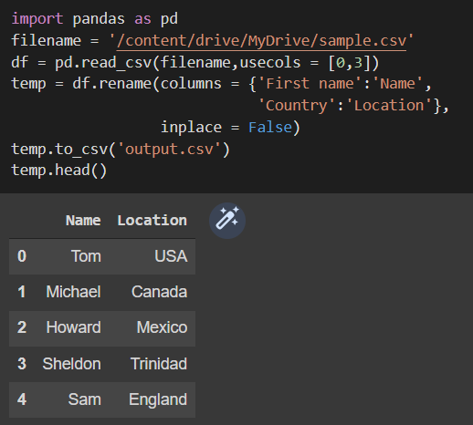
Manipulating data with Pandas
Let us take a sample CSV file which we have seen earlier.
Load the CSV file and take data only from First name and country columns
Then rename the columns as Name and location. Inplace = False parameter is used to specify creation of new dataframe rather than updating the used dataframe.
To_csv() function is used to convert the data frame into csv file and store it on disk

Slide 27
Apply functions on data frames
In Pandas there are built-in methods for most common statistical operations, such as mean or sum, and they apply across one-dimension at a time.
To apply custom functions, we use one of the three methods
To do table wise – pipe ()
Row or column wise – apply()
Element wise – applymap()

Slide 28
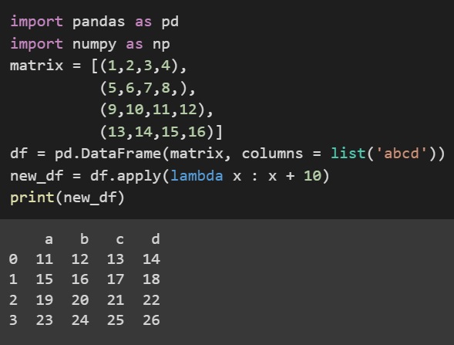
Apply function to each value
Creating a data frame
Creating a lambda function which adds 10
Applying lambda function on each element to add a value of 10 for every element

Slide 29
Apply a function to each series
Apply series_to_* function to every column by default (across rows):
Df.apply(series_to_series) : returns a dataframe
Df.apply(series_to_value) : returns a series
To apply the function to every row (across columns) set axis = 1
Df.apply(series_to_series, axis = 1)
Apply a function that receives dataframe and returns data frame
Df.pipe(df_to_df) : return data frame

Slide 30
Assignment on Pandas
Take a matrix and implement matrix multiplication logic using pandas apply function on each column to compute the result.
Implement Merge sort logic using pandas dataframes
Import any csv file using Pandas and reindex the dataframe. Reshape the pandas dataframe and store only data related to any 2 columns
Implement changing index columns and row indexes in pandas

Slide 31
Summary

Slide 32
Q&A

